Slide 1
Power BI
Cards and filters

Slide 2
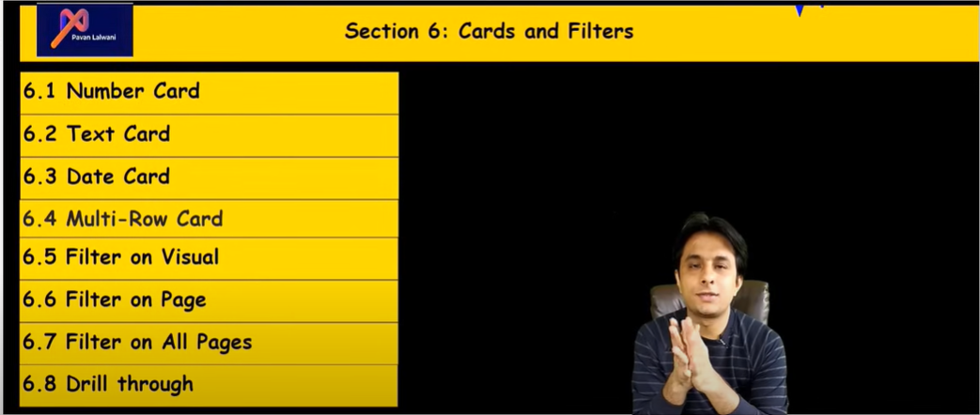

Slide 3
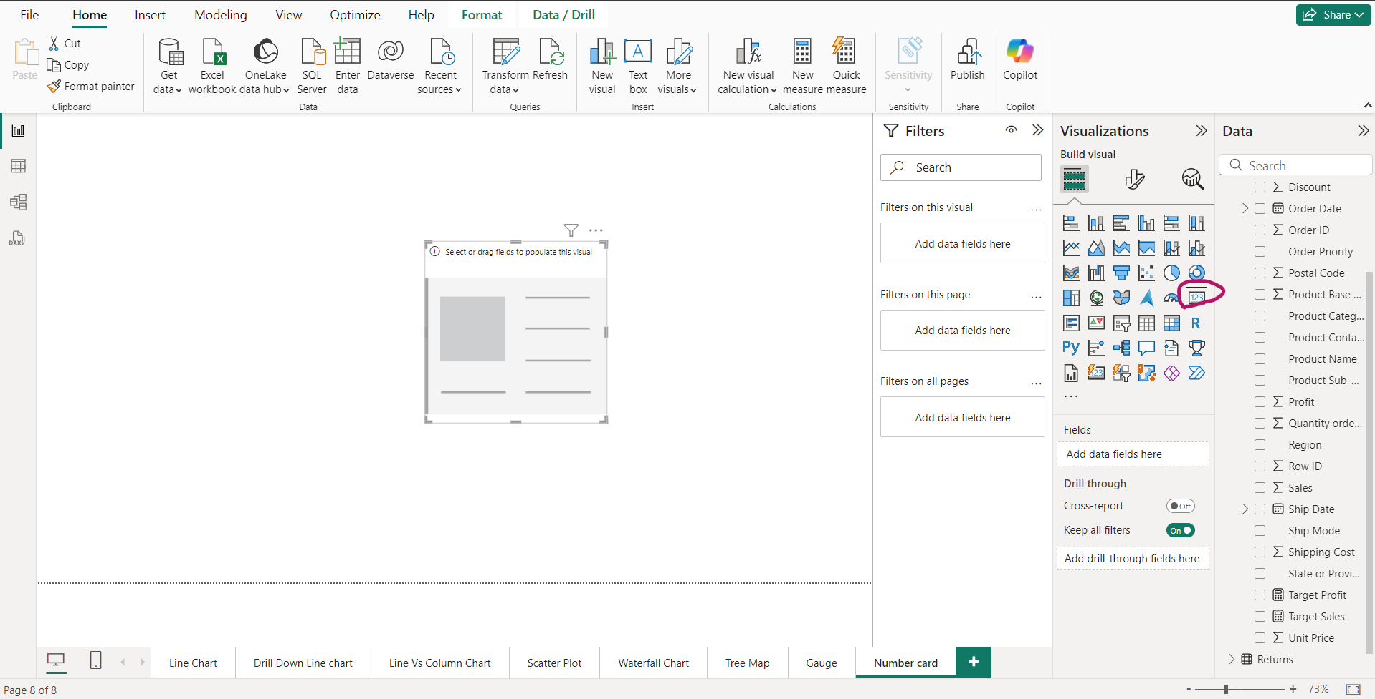
Number Cards

Slide 4
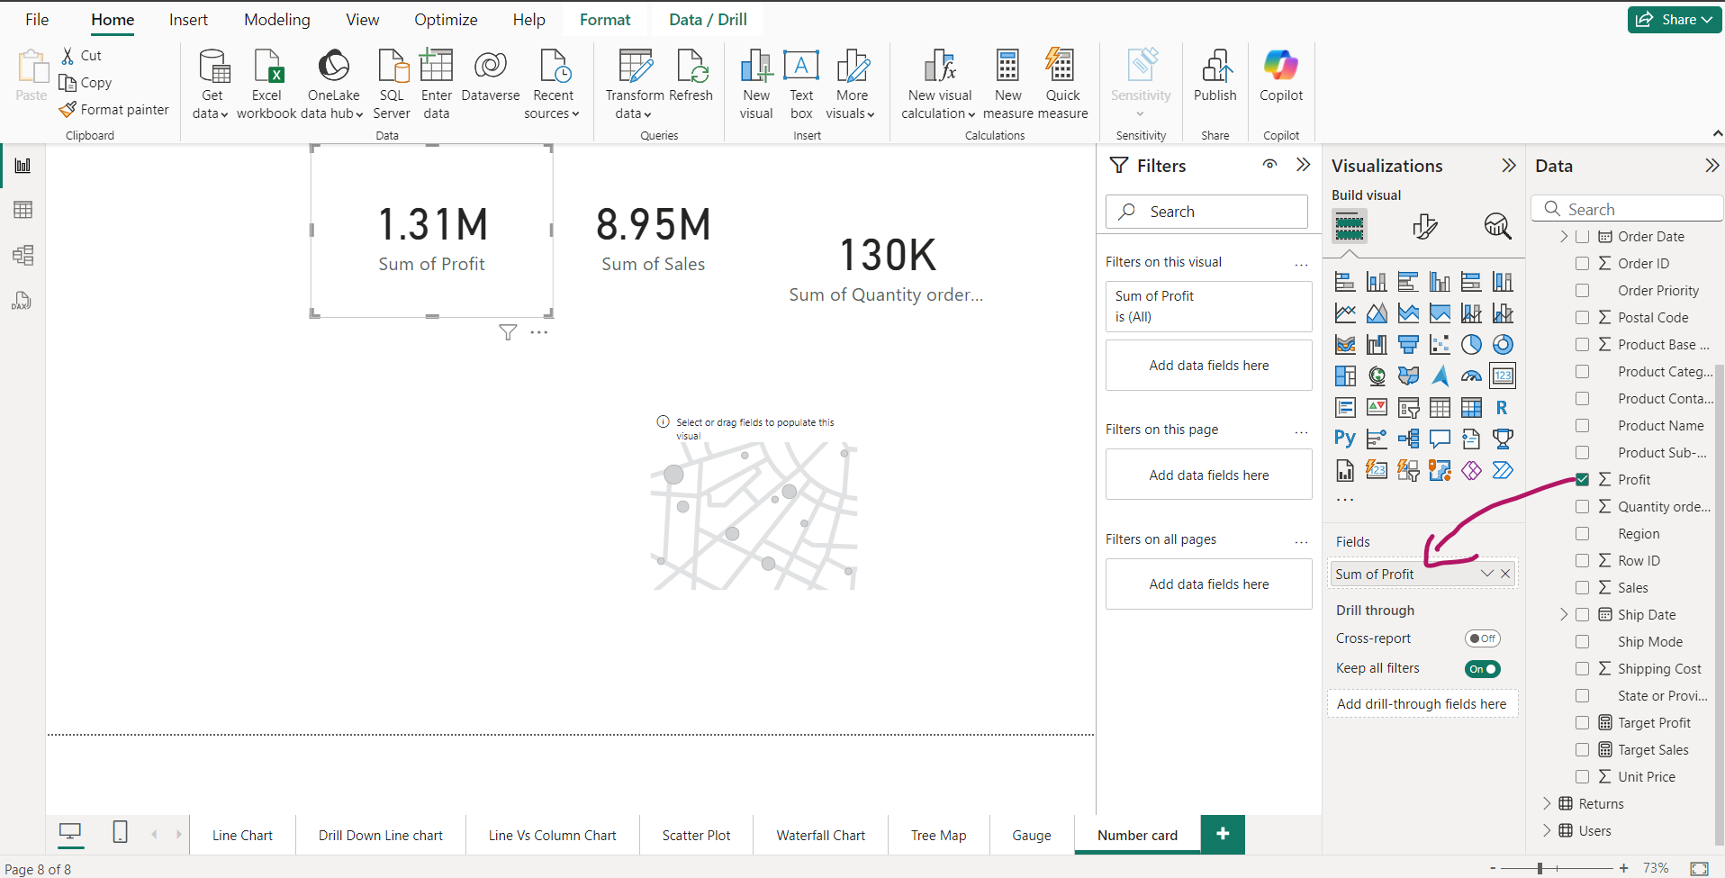
Number Cards-1 for showing Profit

Slide 5
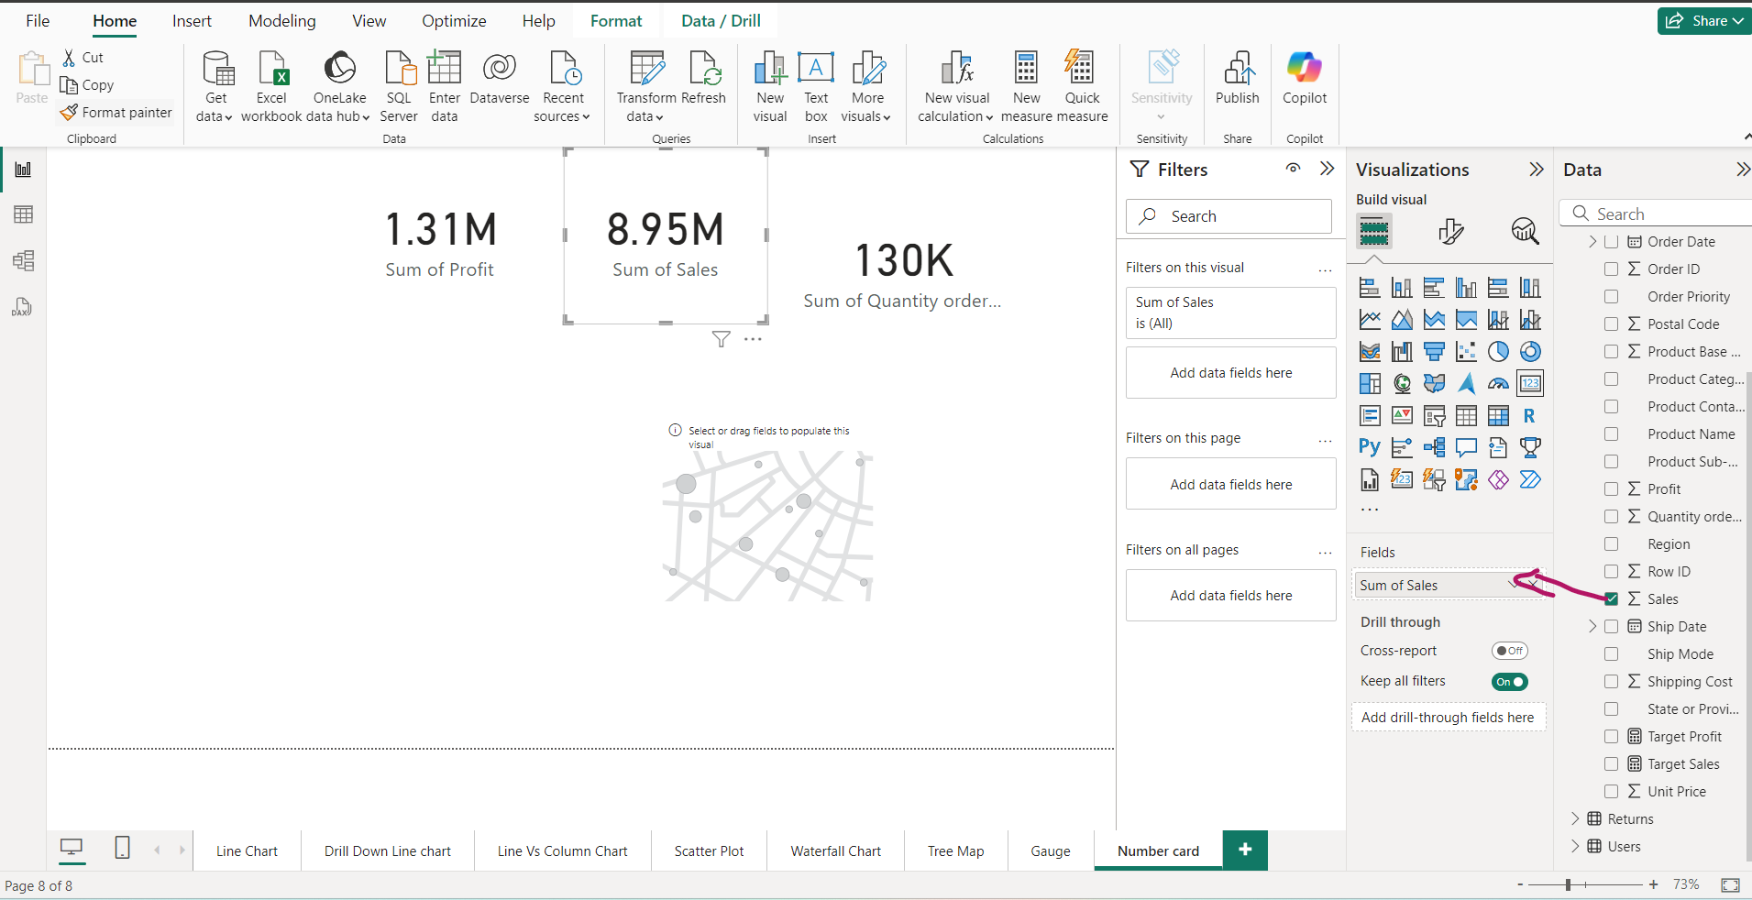
Number Cards-2 for showing Sales

Slide 6
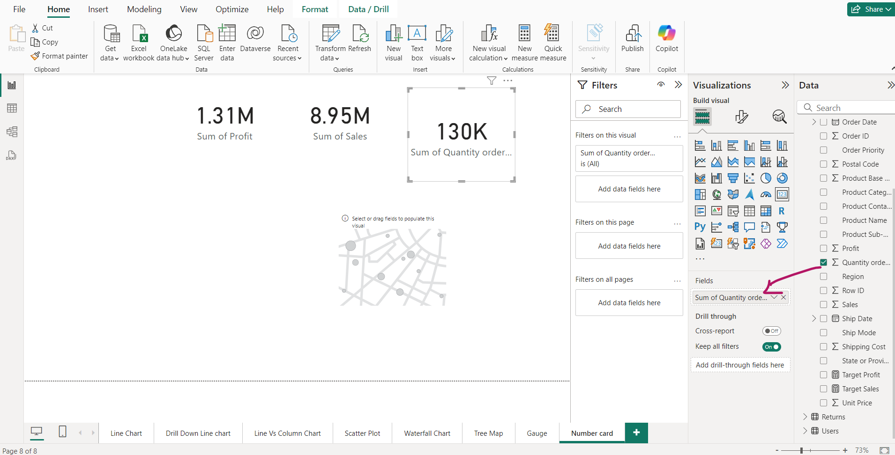
Number Cards-3 for showing Quantity

Slide 7
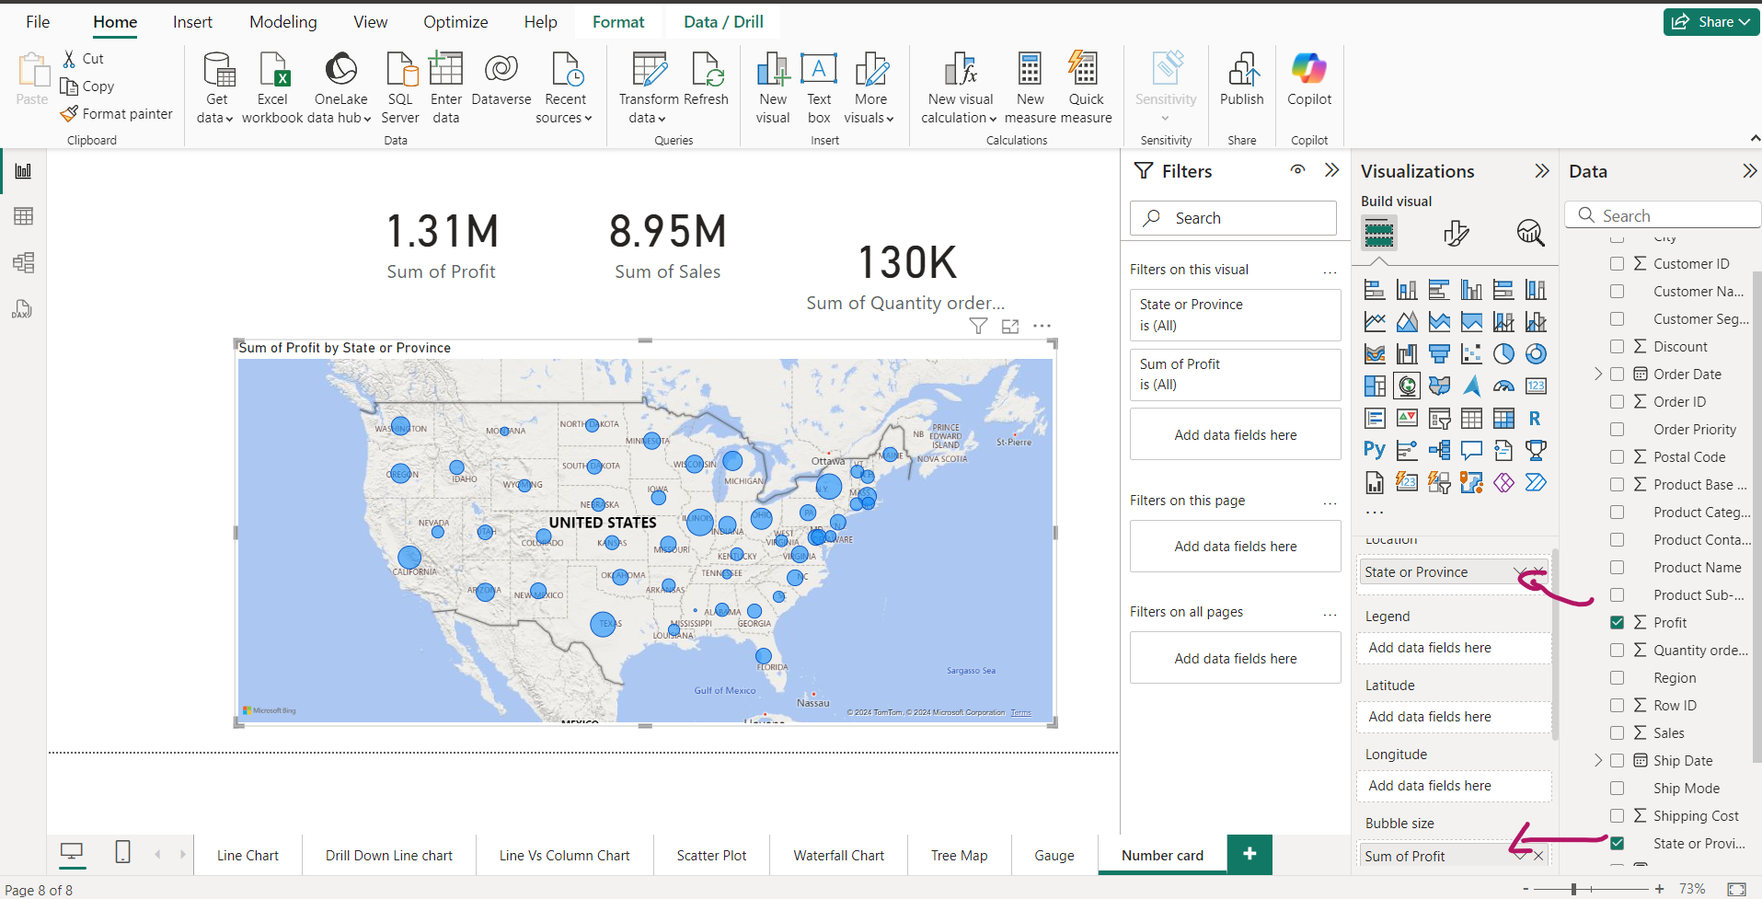
Number Card along with map

Slide 8
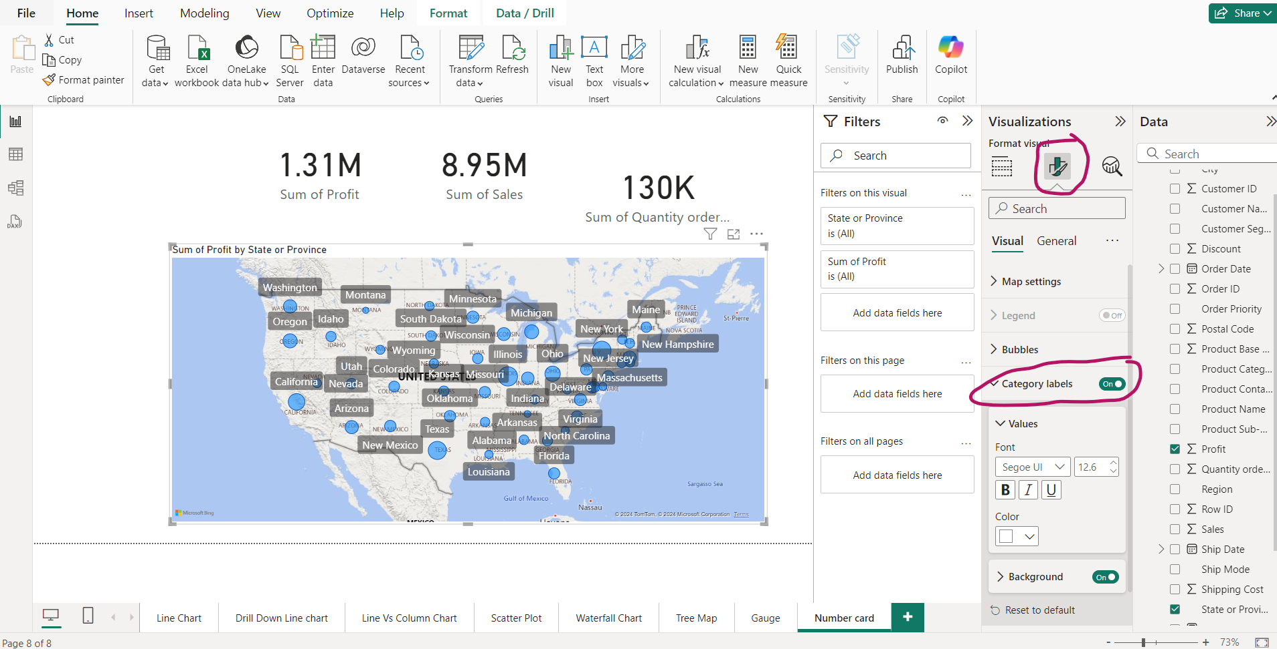
Enable map Labels and check their figure changes on Number cards

Slide 9
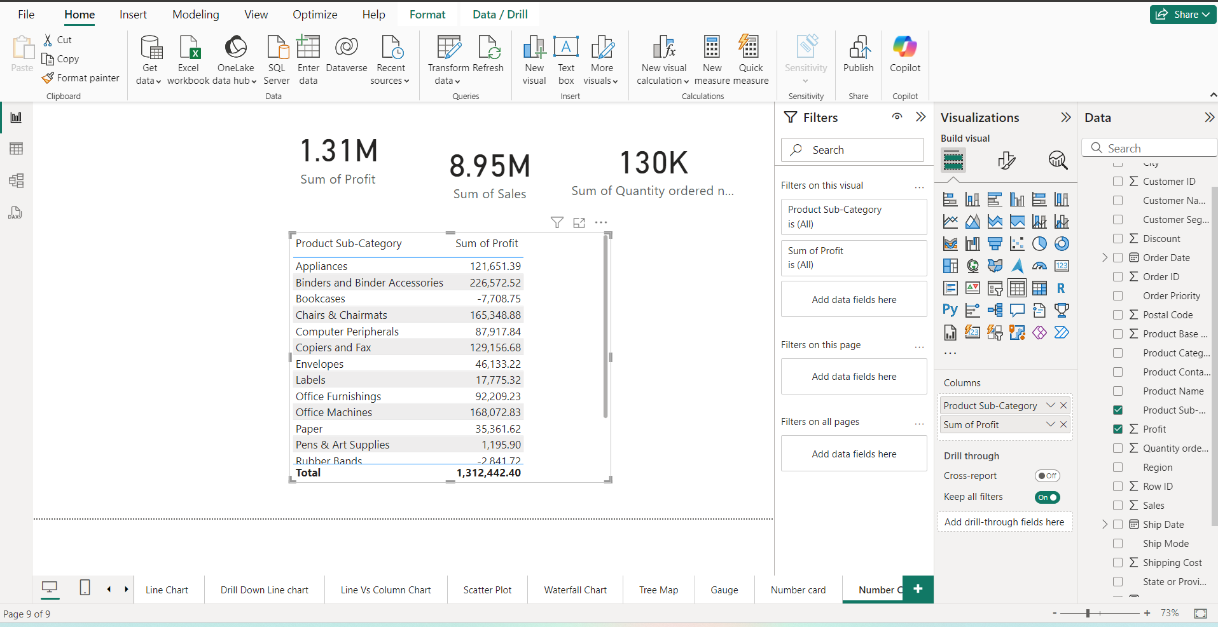
Number Card relation with a table

Slide 10
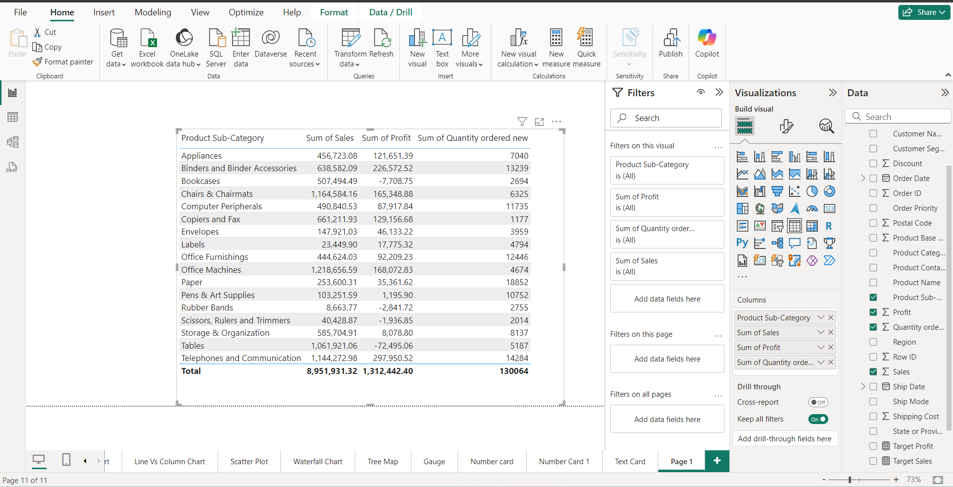

Slide 11
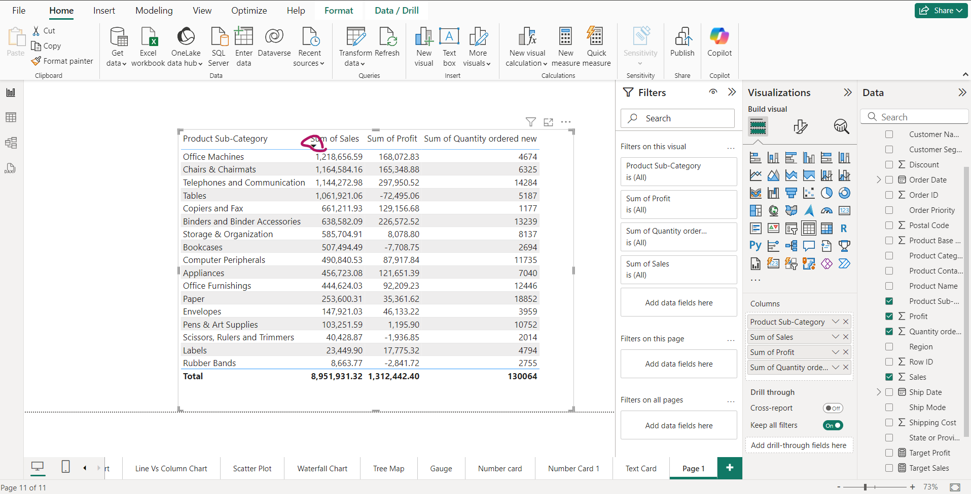
Highest Selling sub-category is Office Machine

Slide 12
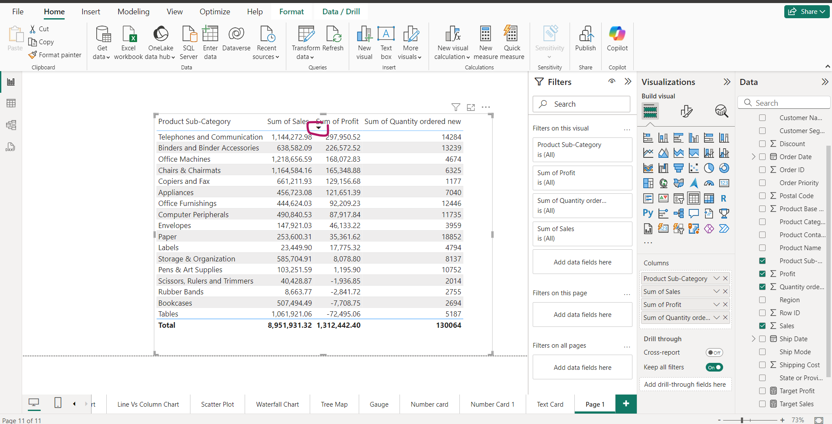
Bigest sum of Profit is of “Telephones and Communication”

Slide 13
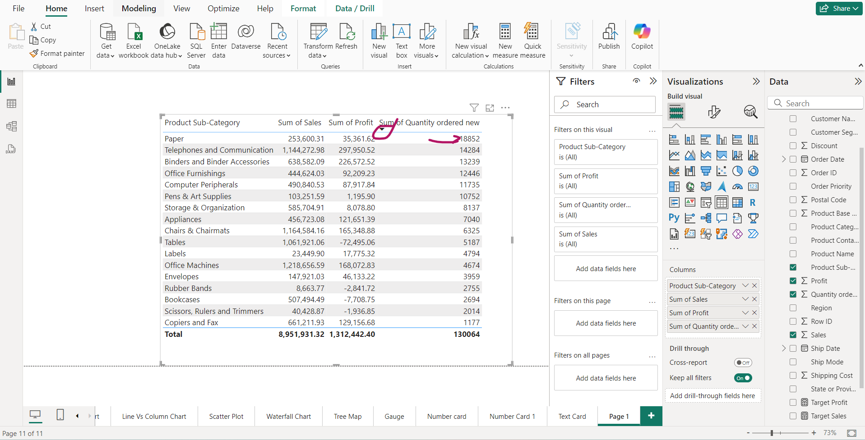
Biggest Quantity is of Paper

Slide 14
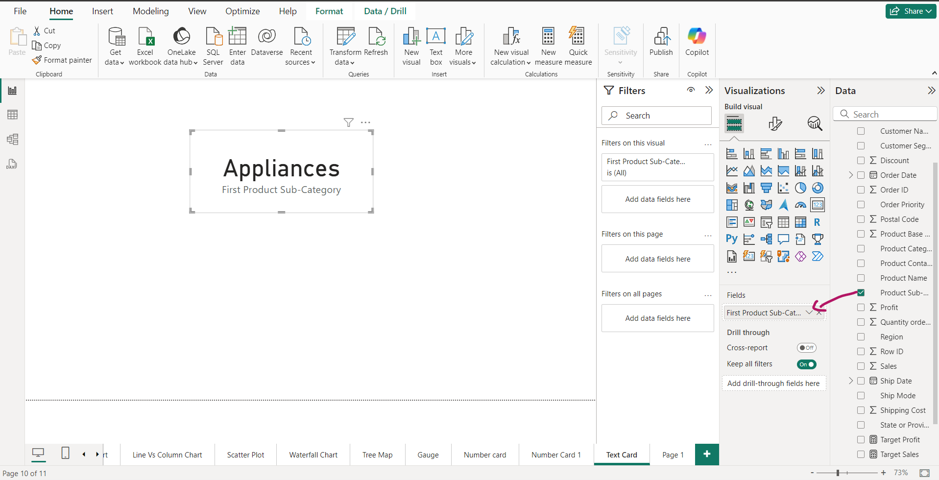
Text card- Drag Product Sub category into Cards

Slide 15
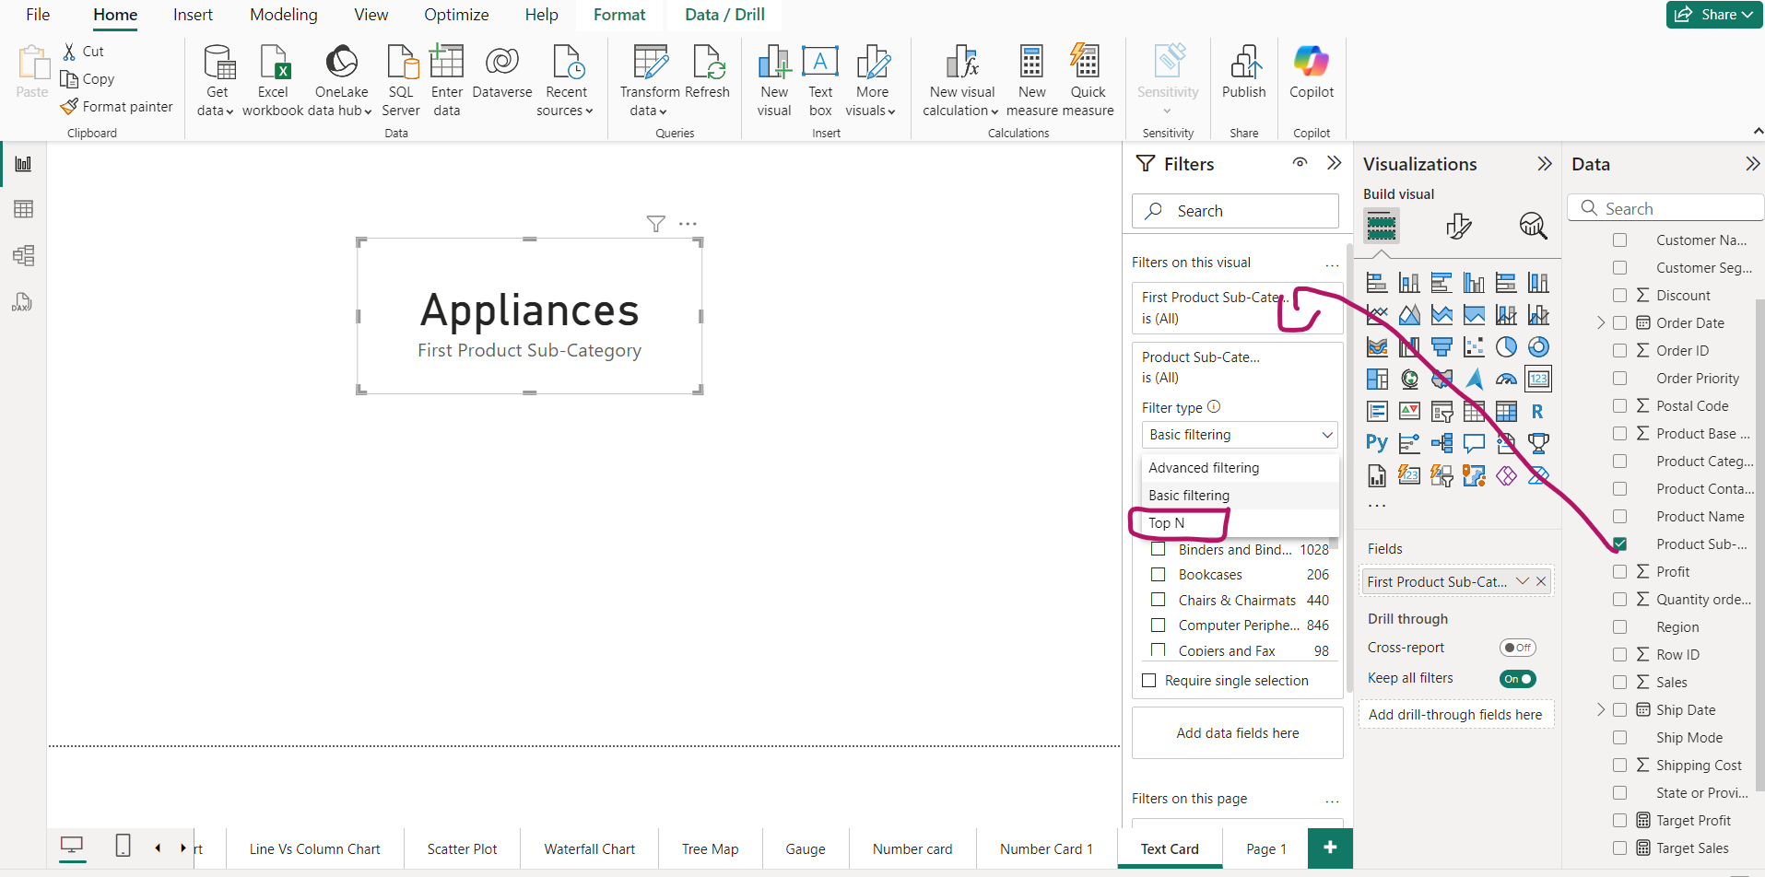
Text Cards-Apply Filters

Slide 16
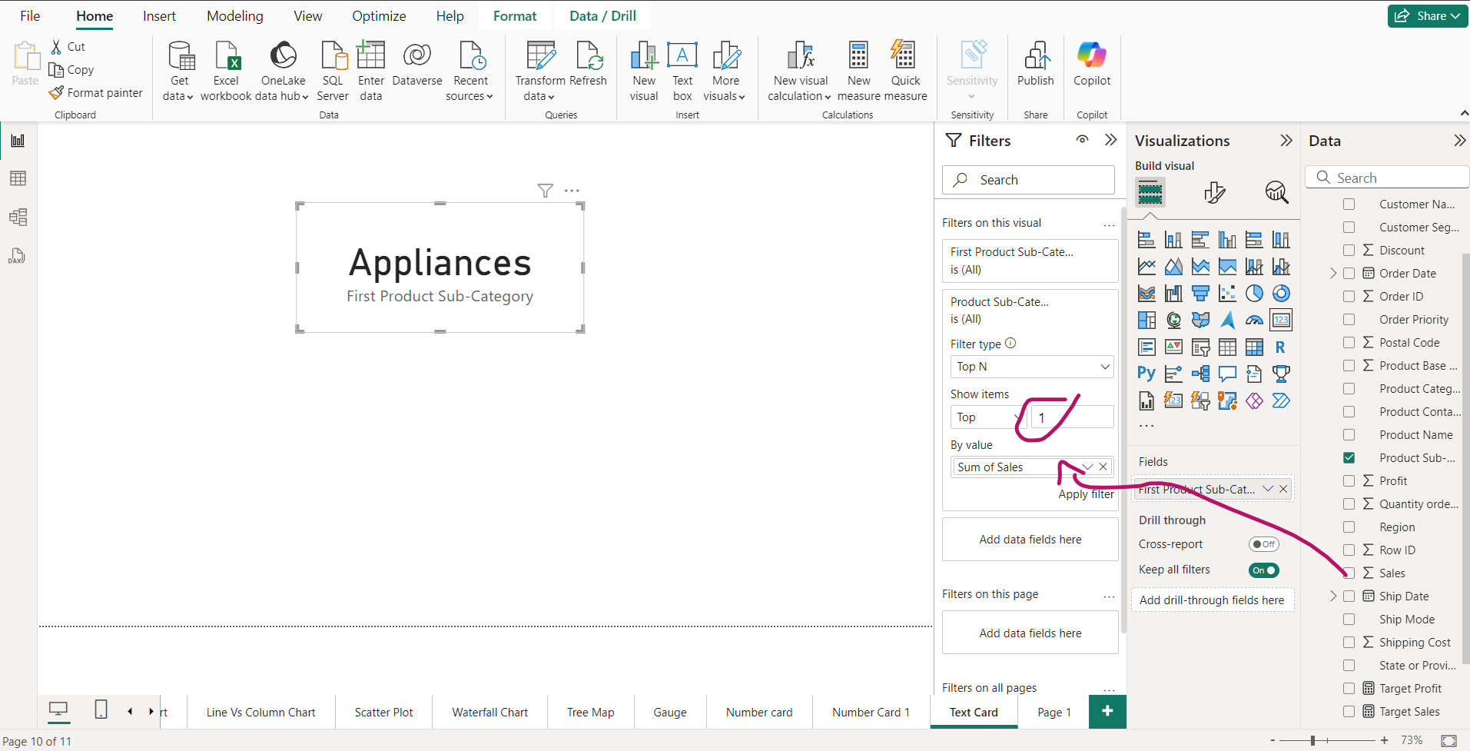
Text cards- Setting filter to find higest sales of Product sub-category

Slide 17
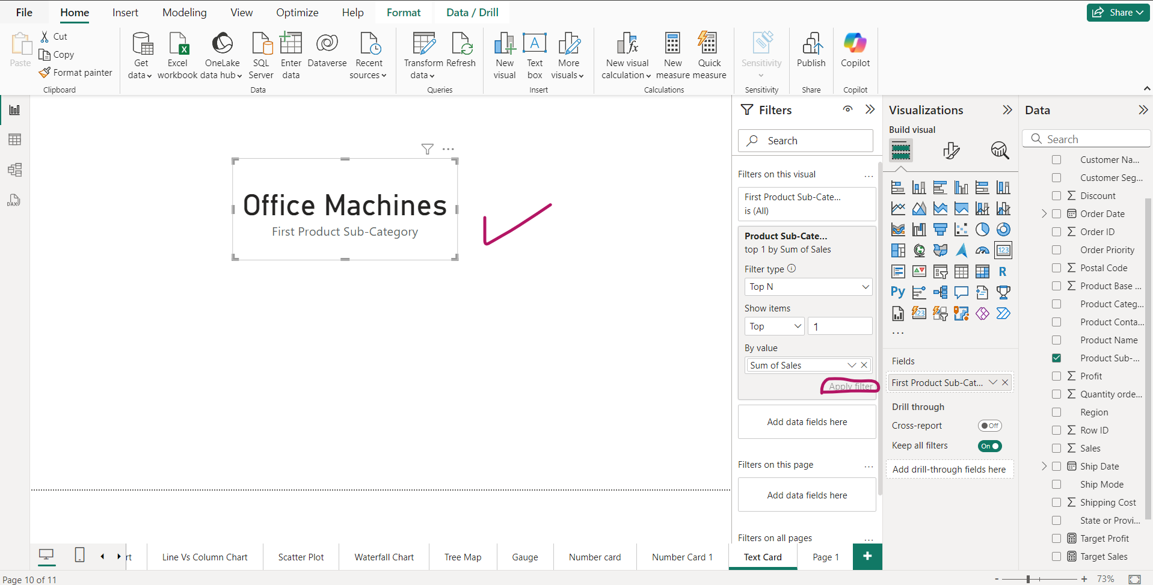
Click on “Apply filter”

Slide 18
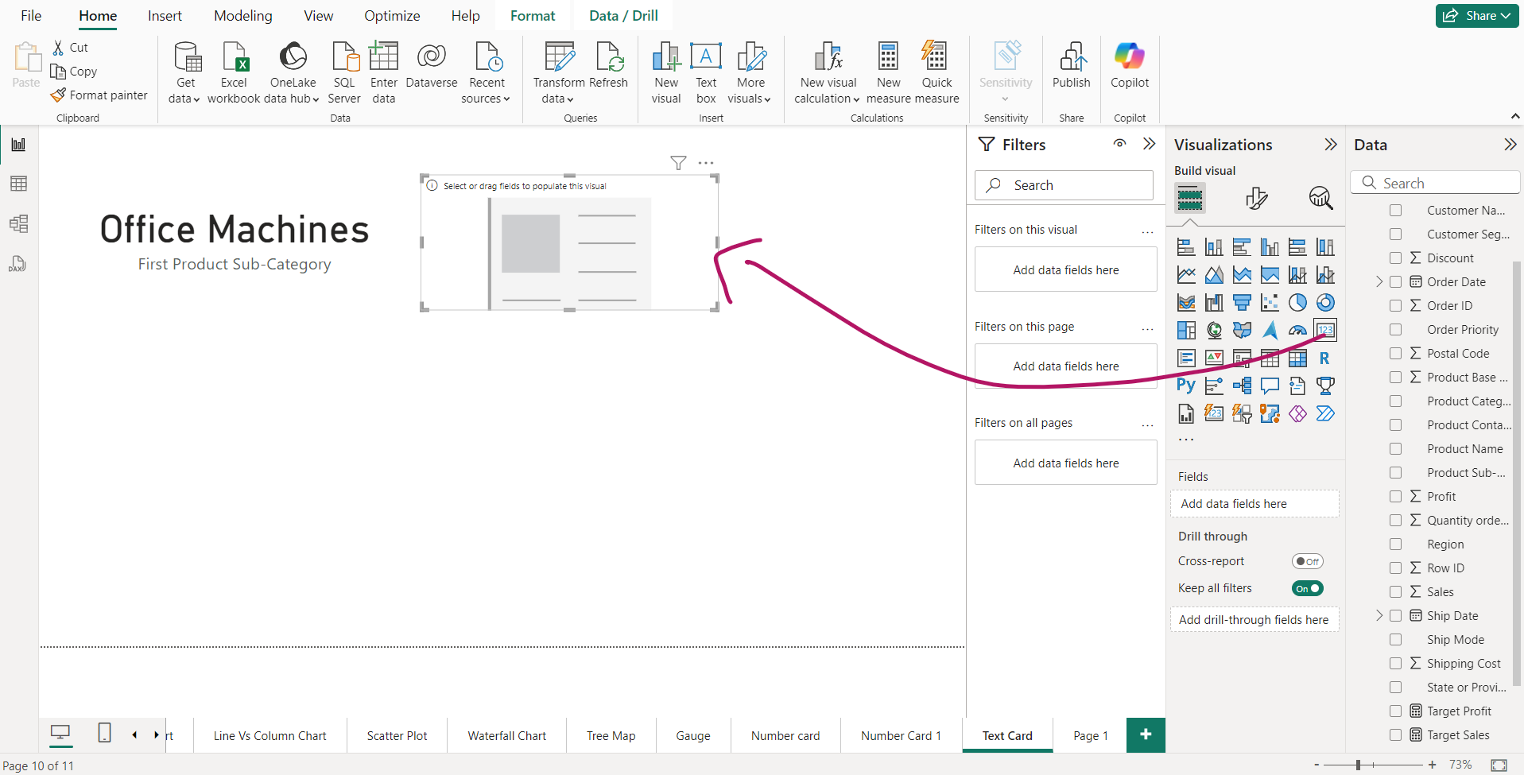
Text Card- drag n drop Another Text Card

Slide 19
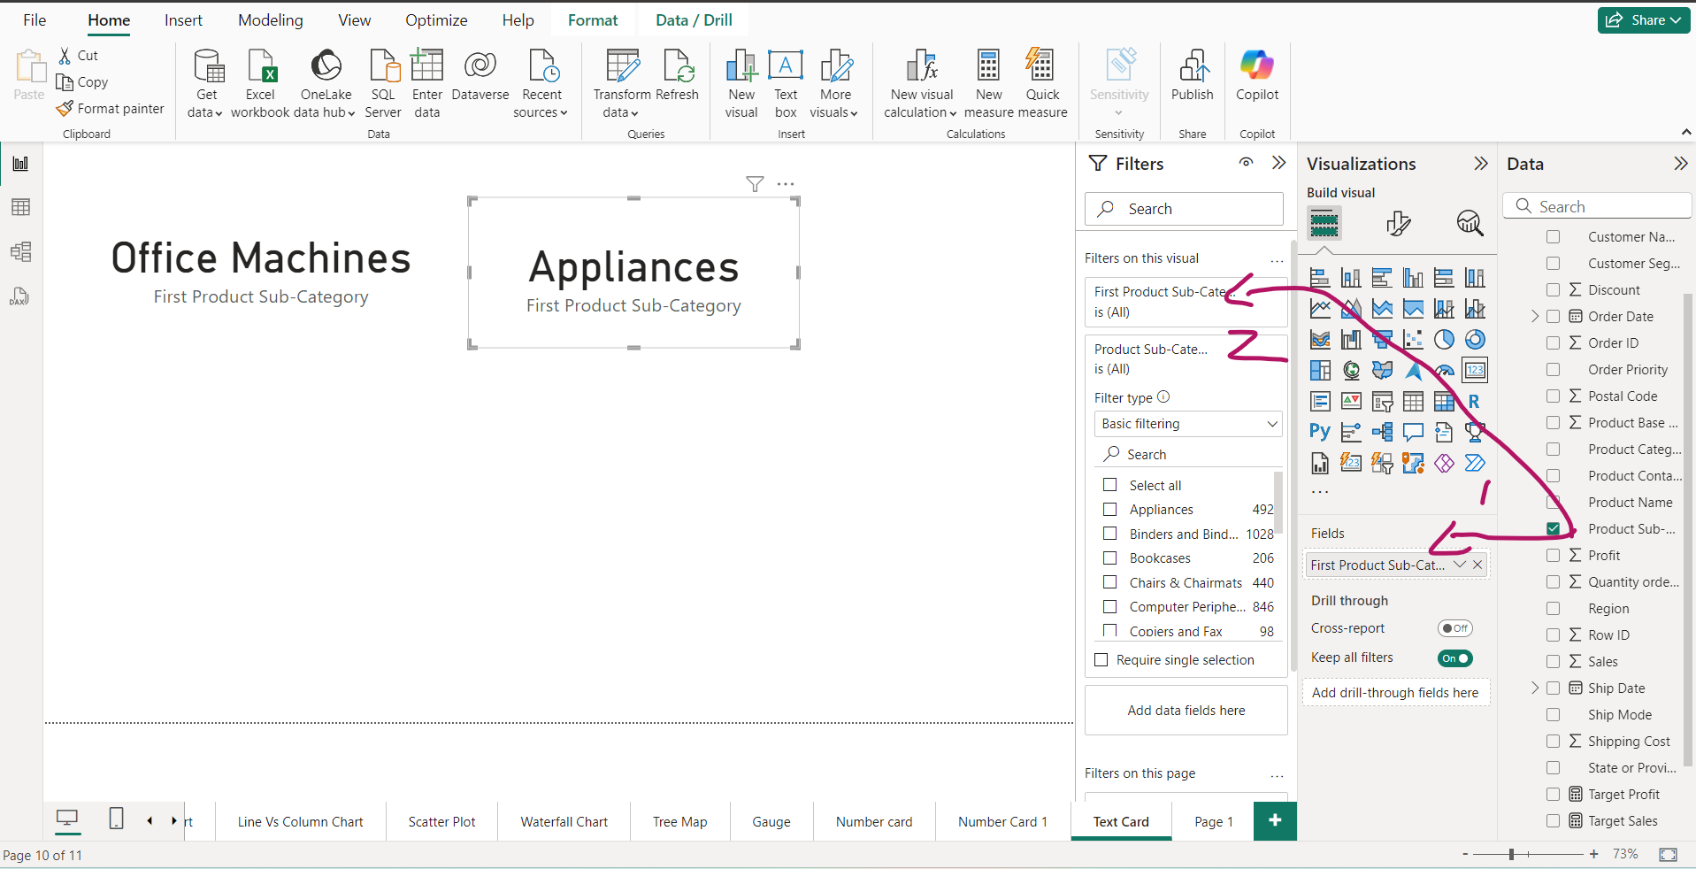
Text Card-Apply filter to find highest profit from Product sub-category

Slide 20
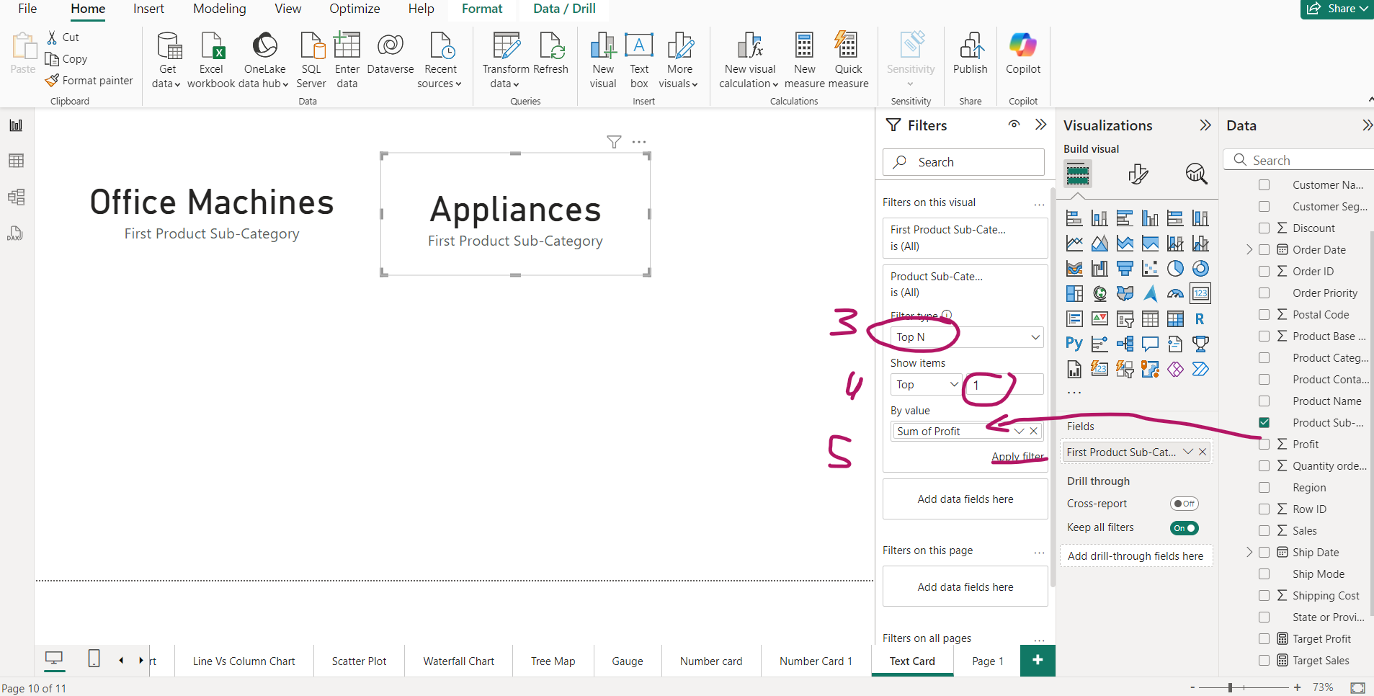
Text Card-Apply filter to find highest profit from Product sub-category

Slide 21
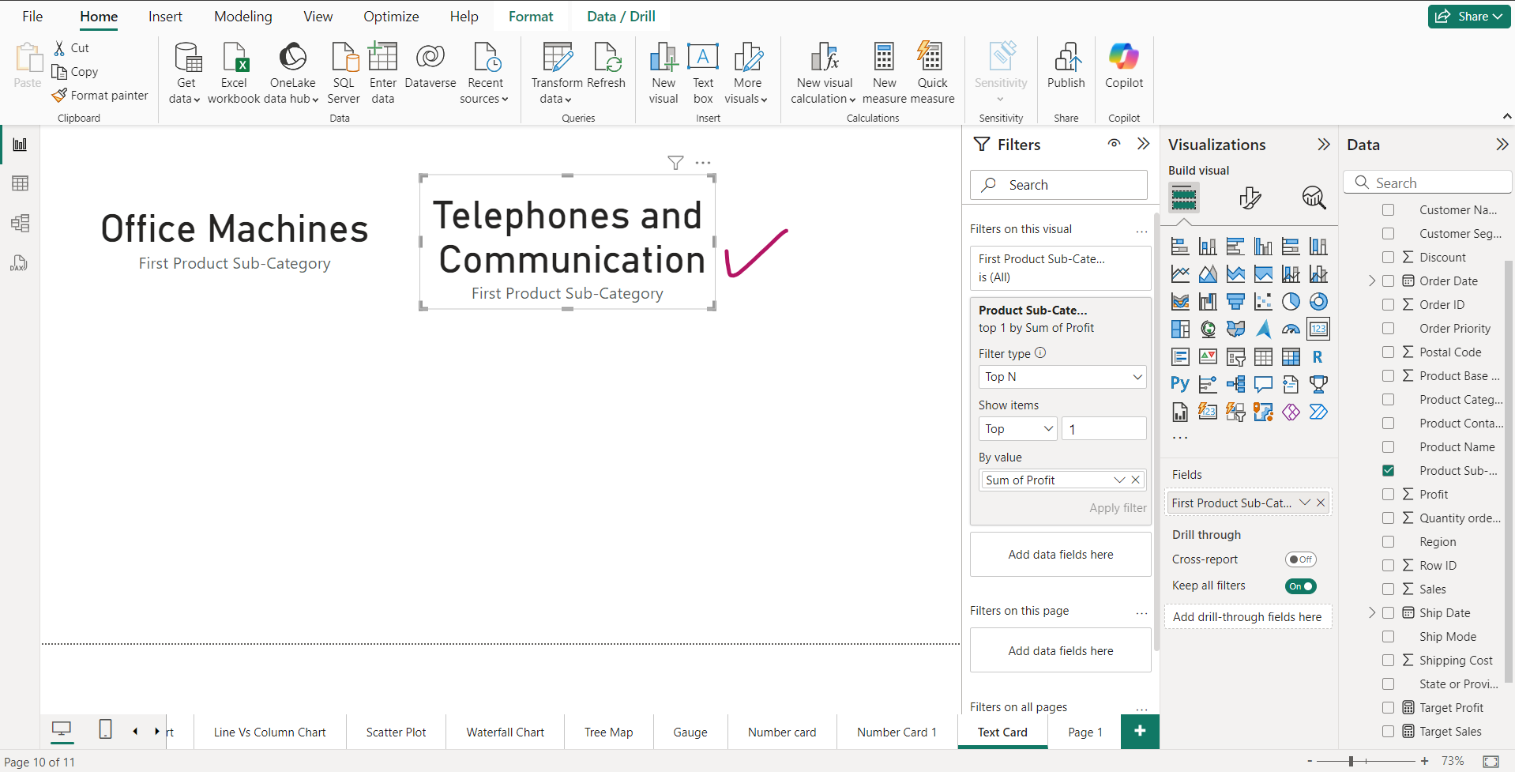
Text Cards-Telephones and Communication have highest Profit

Slide 22
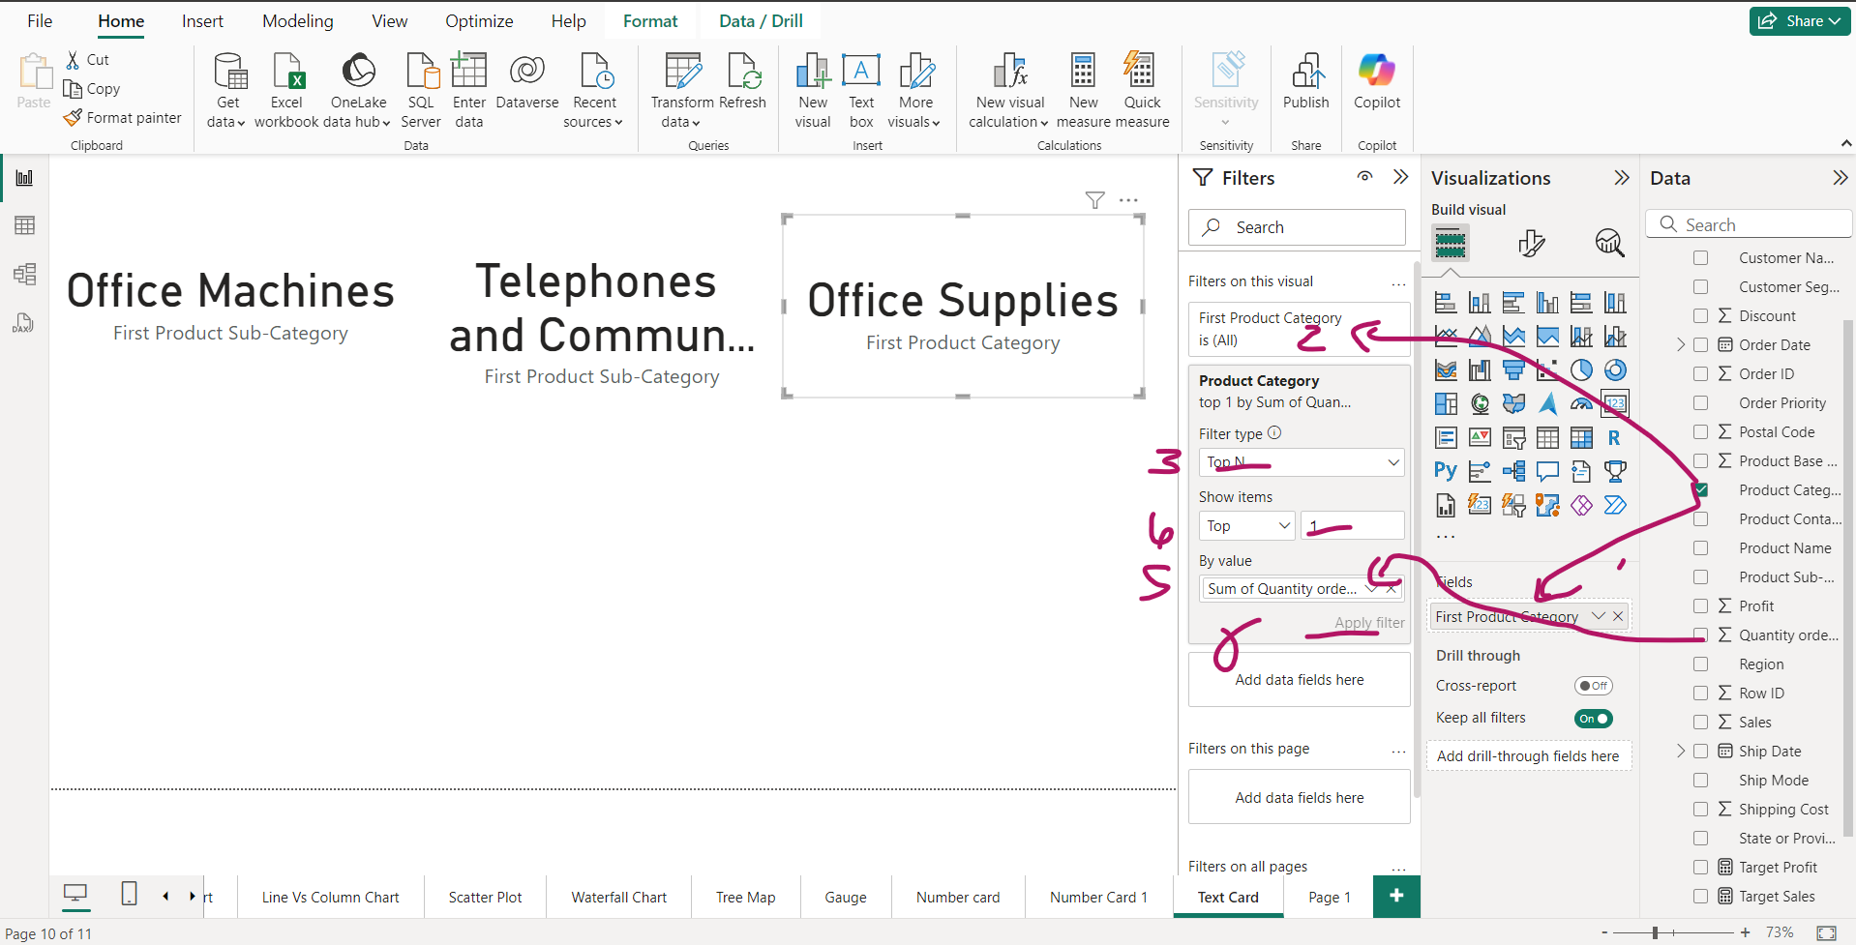
Line vs Stacked column chart- Profit vs Sales

Slide 23
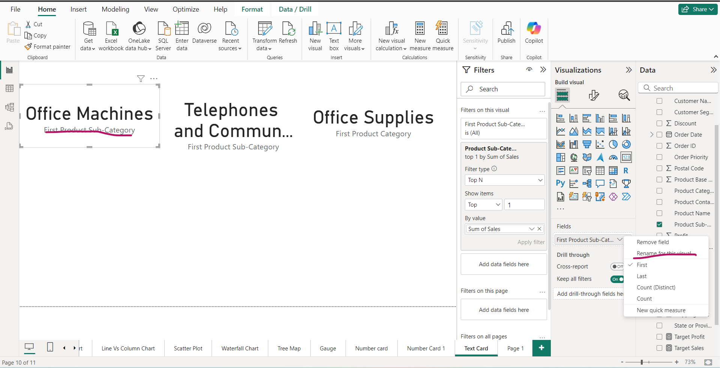
Rename and format cards

Slide 24
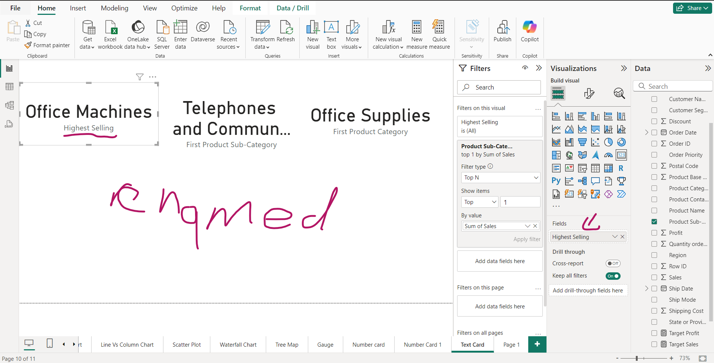
Renamed

Slide 25
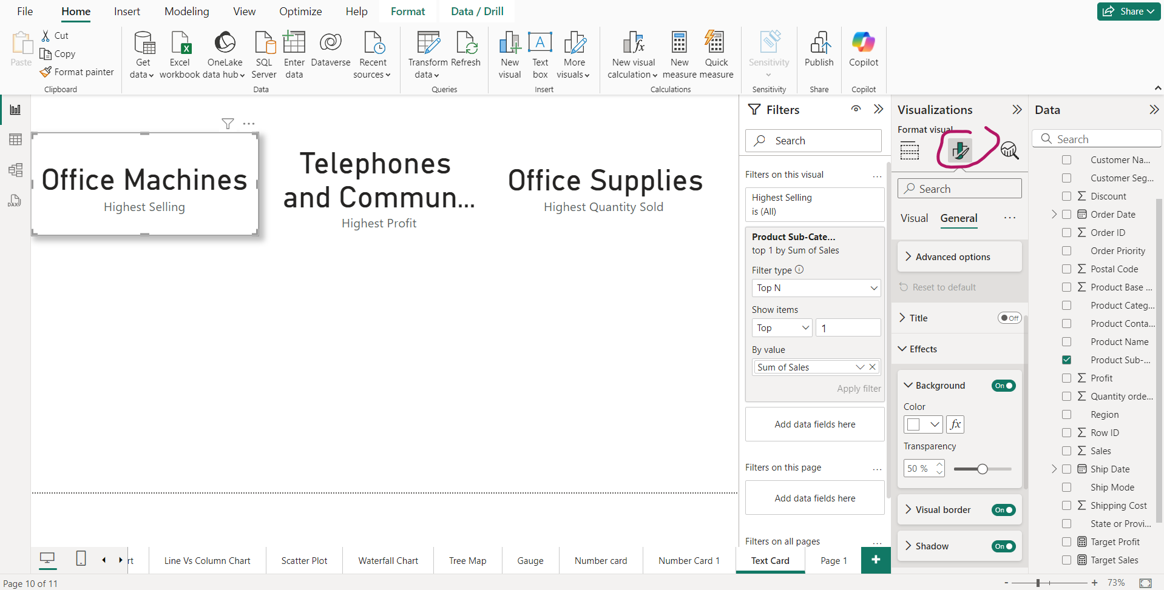
Goto Visuals and general section for formatting

Slide 26
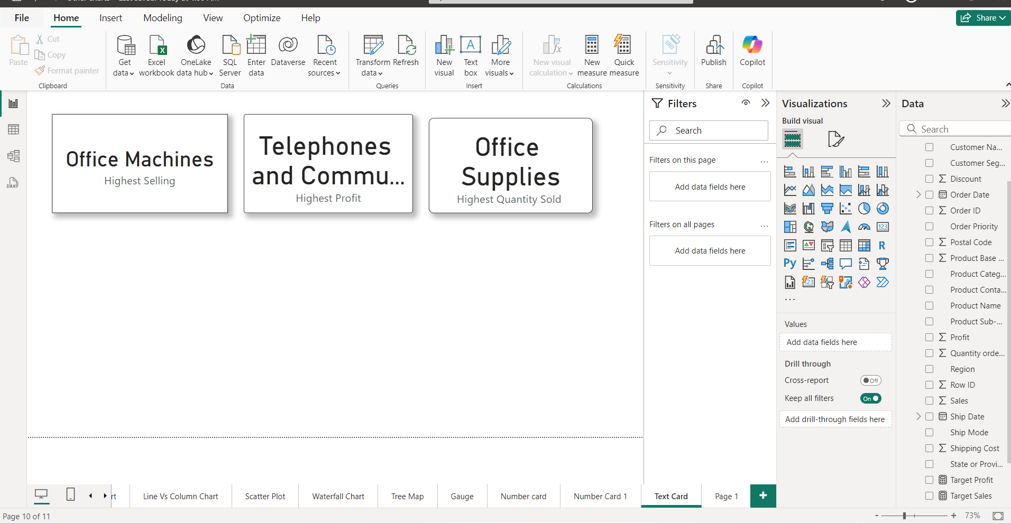
Explore Formatting

Slide 27
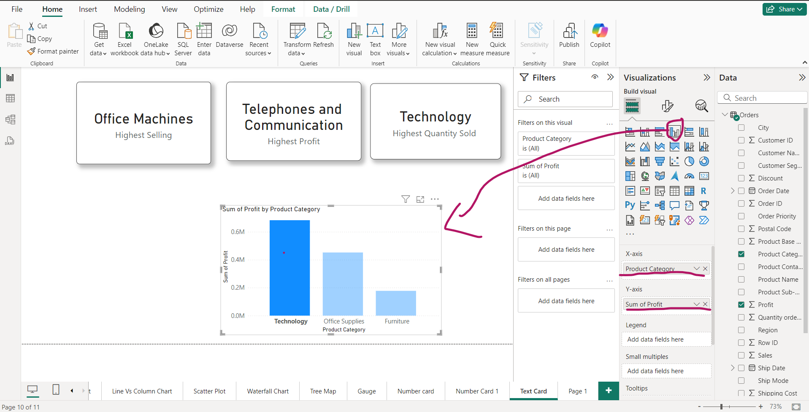

Slide 28
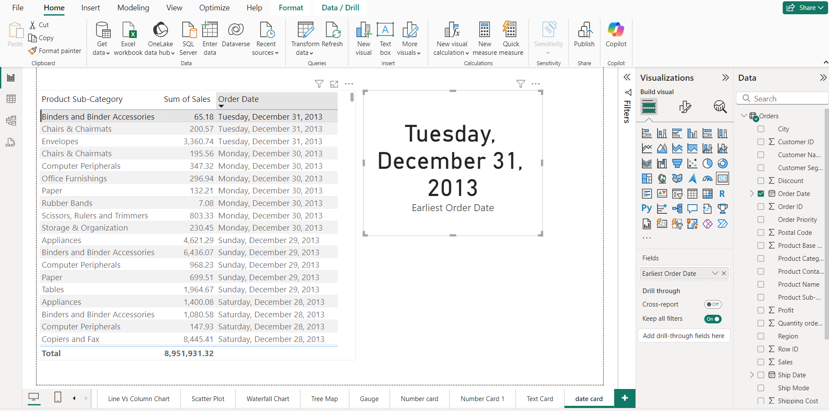
Date Card

Slide 29
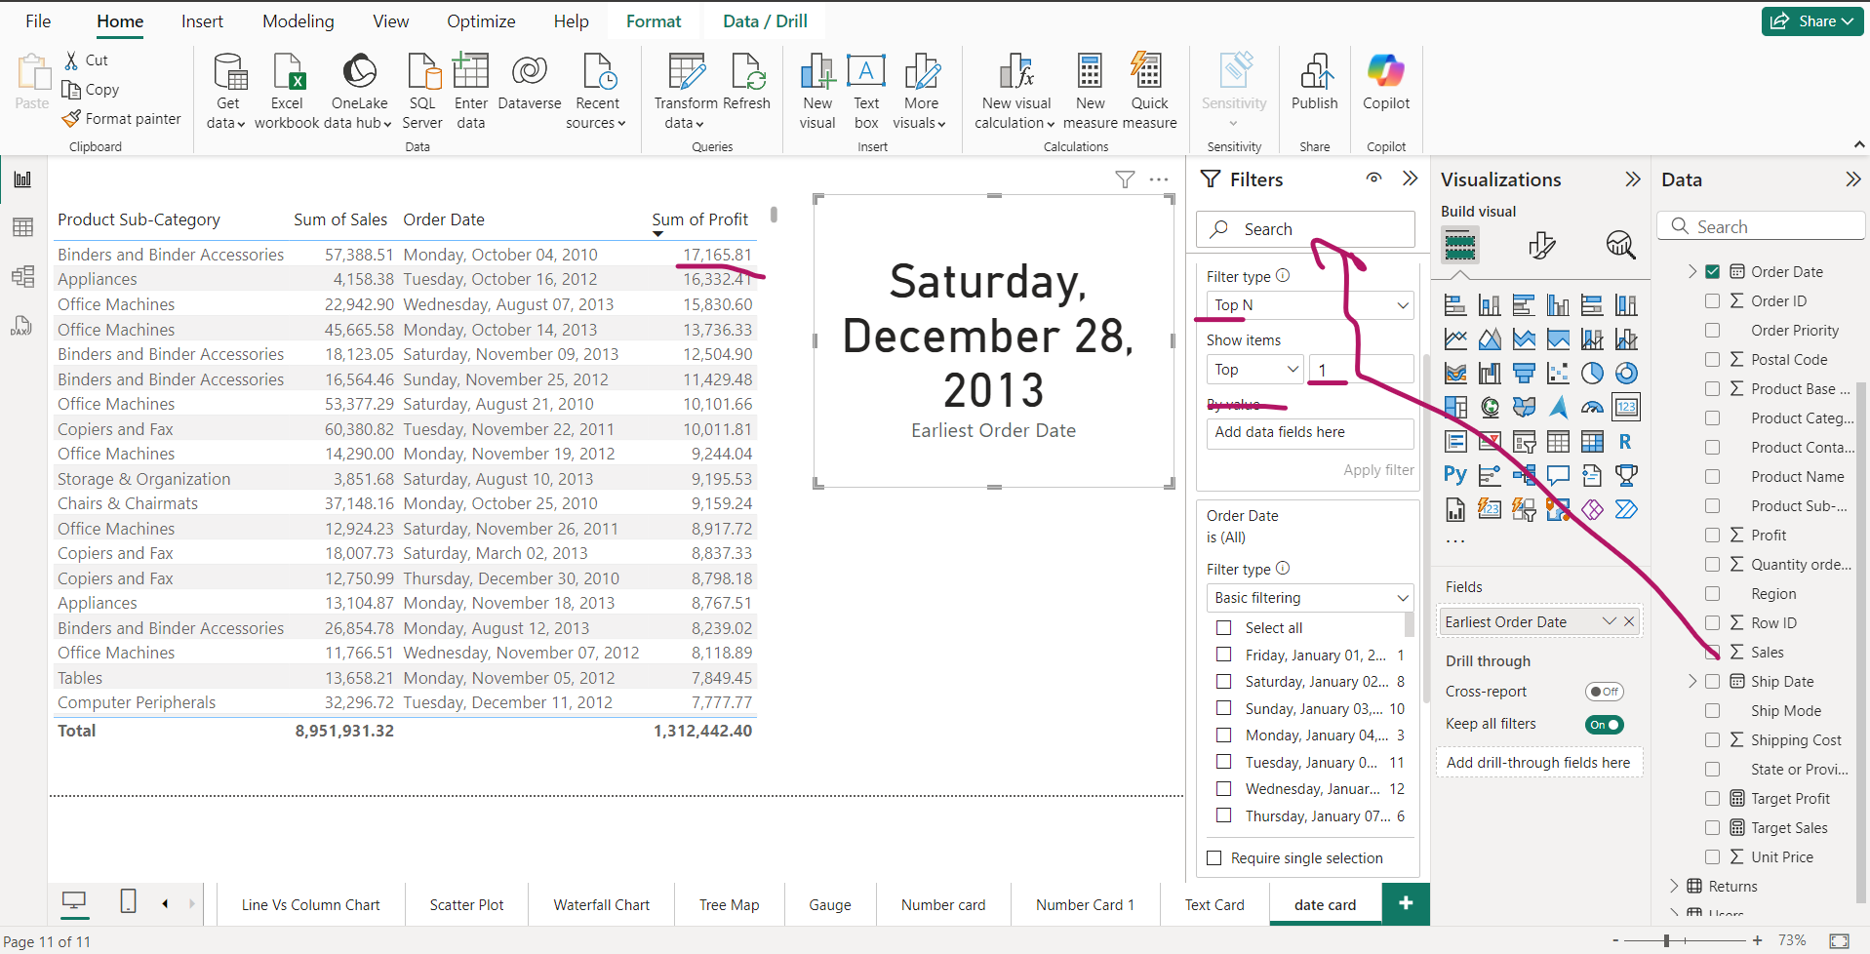
Highest Salas Date wise

Slide 30
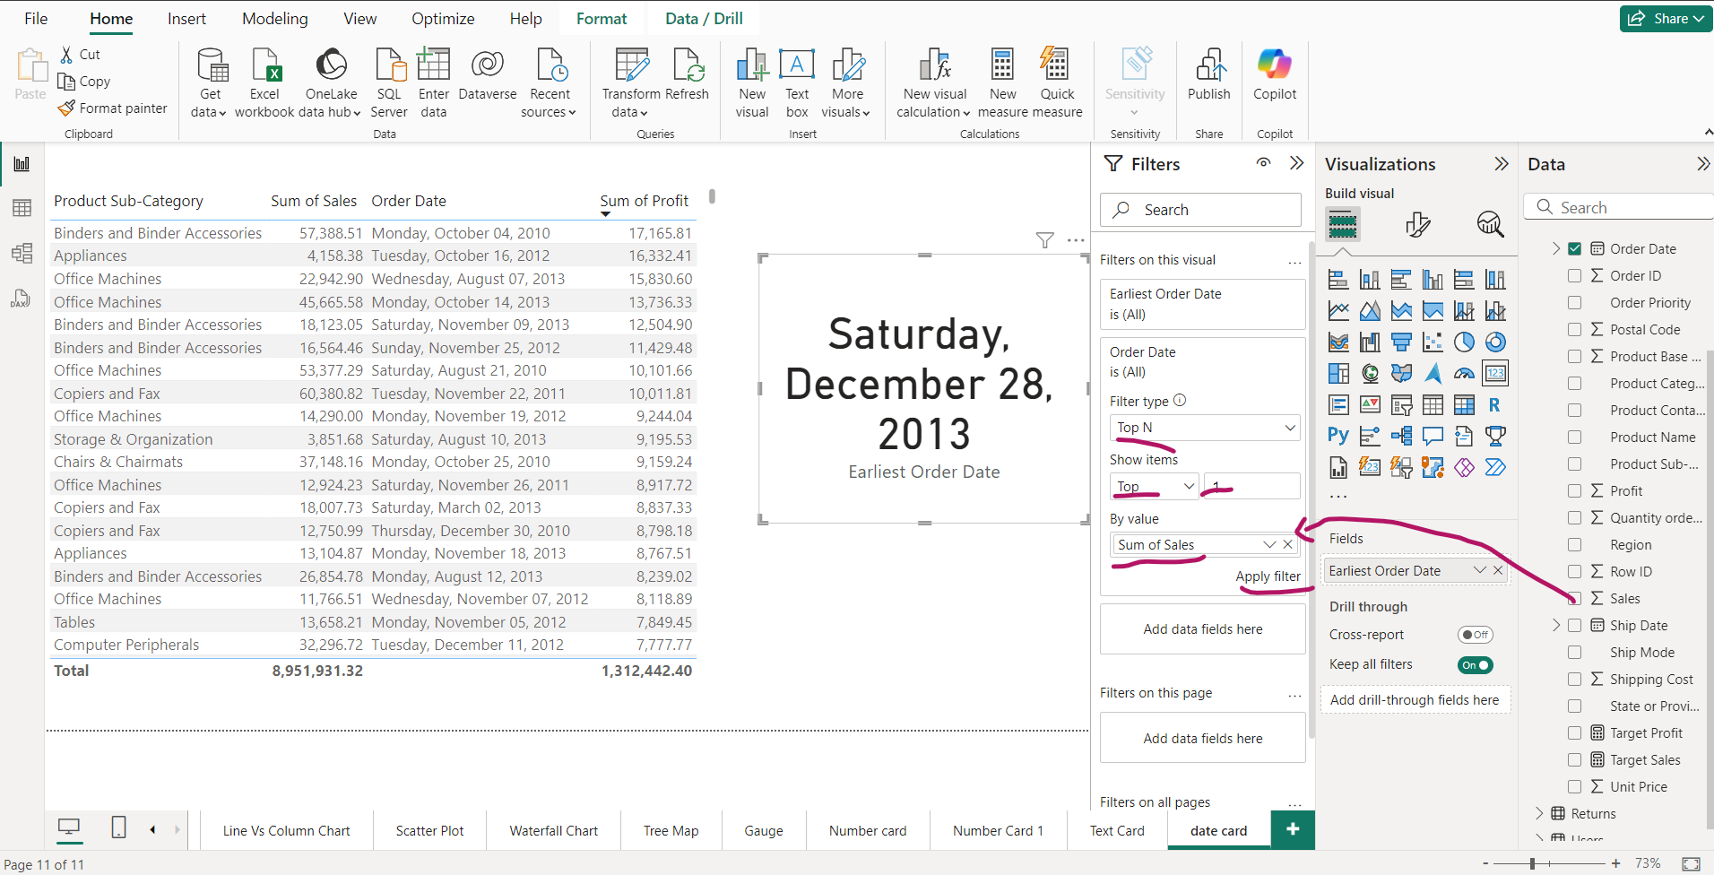
Highest Sales date wise-Contt

